Slide 1
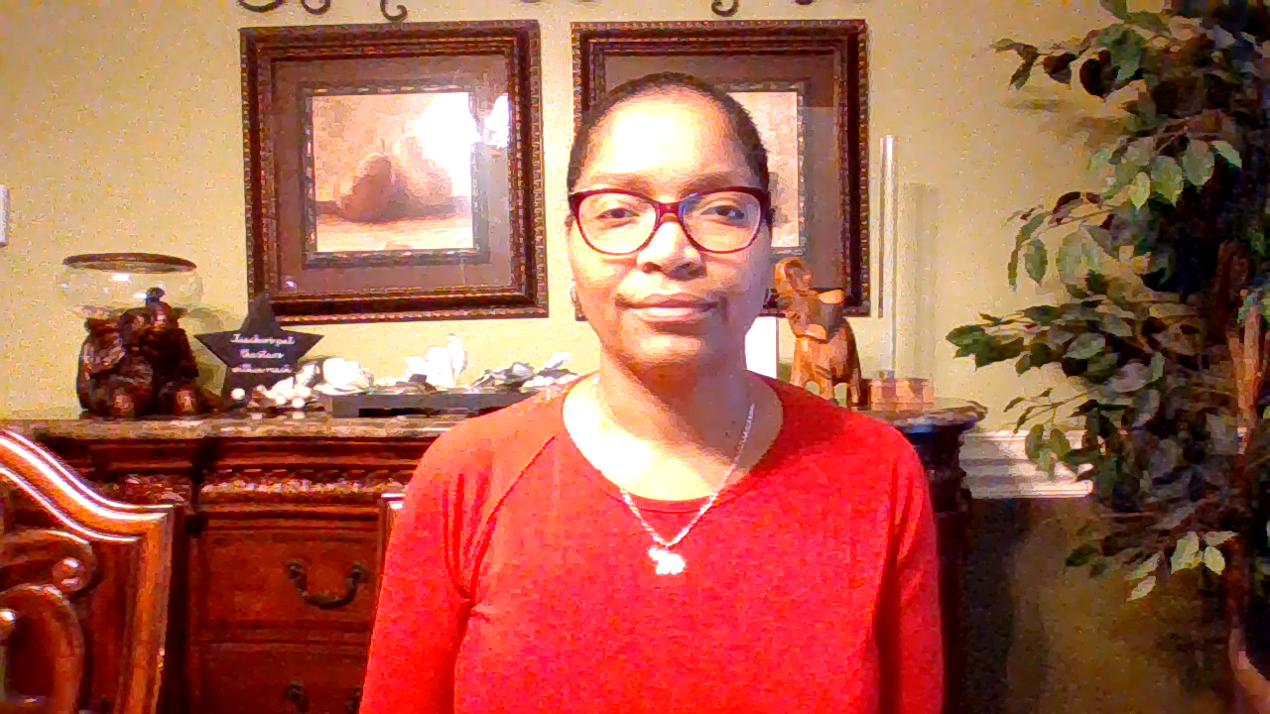
Rosalind Blake
Instructional Facilitator

Slide 2

Black History Month
Stacey Yvonne Abrams

Slide 3
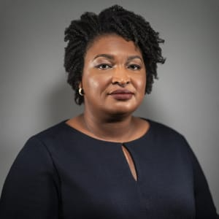
Stacey
Yvonne
Abrams

Slide 4
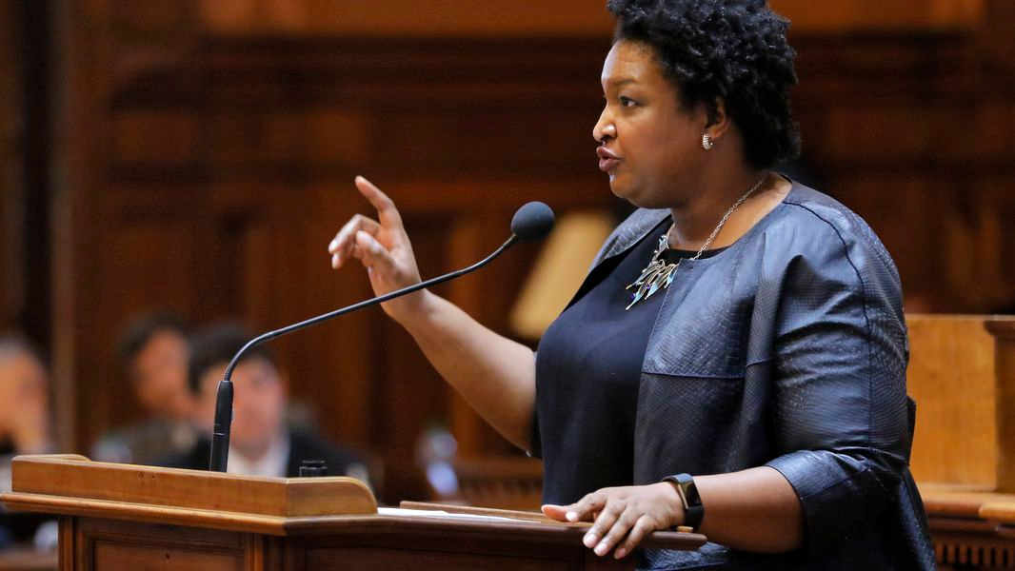
Politician, lawyer, author, activist and Nobel Prize nominee Stacey Abrams served in the Georgia House of Representatives from 2006-2017.

Slide 5
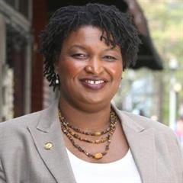
Abrams received degrees from Spelman College (Atlanta’s historically Black women’s college), the LBJ School of Public Affairs at the University of Texas and Yale Law School.

Slide 6
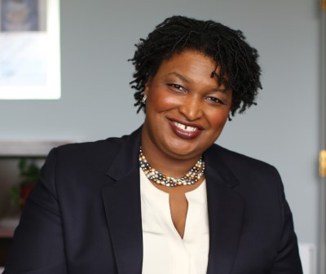
Stacey Abrams became the first woman to lead either party in the Georgia General Assembly in 2010, occupying the role for her last seven years in office.

Slide 7
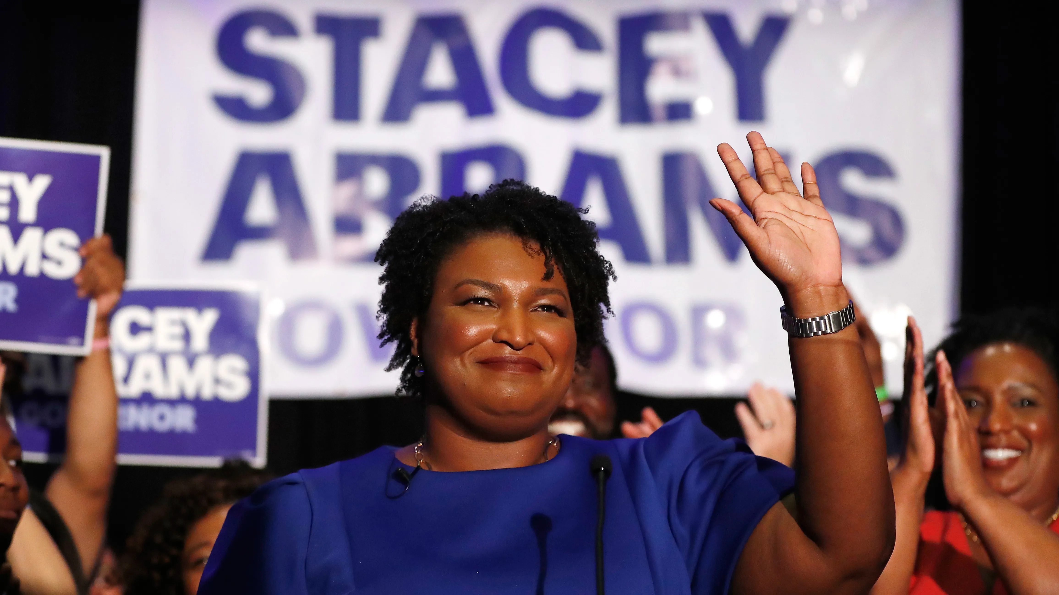
Following an unsuccessful run for Georgia governor in 2018 (where she won more votes than any other Democrat in the state's history), Abrams founded Fair Fight to help end voter suppression. Fair Fight is an organization that helped register at least 800,000 new voters in Georgia ahead of the 2020 general election.

Slide 8


In addition to her political career, she’s also a New York Times best selling author. She has published many books including eight romantic suspense novels under the pen name Selena Montgomery.

Slide 9
